Slide 1



Title I Annual Parent Meeting
Belleair Elementary
October 20, 2022
5:30-6:00
Renee Kelly
Notes:
Evidence: Upload completed presentation and recorded feedback as part of the evidence to support the Annual Meeting Materials. Do not forget the sign-in sheets, and survey/feedback that you receive throughout the meeting.

Slide 2

All About Title I
Title I is the largest federal assistance program for our nation’s schools.
The program serves 75 schools in Pinellas County including eligible students in 36 non-public schools.
Notes:
Highlight the Title I Program here in Pinellas County.

Slide 3
Title I Funding Process
Pinellas County Schools
Increased Student Achievement
Federal Government
1
3
2
4
Florida Department of Education
Belleair Elementary
Notes:
The Florida Department of Education receives funds from the federal government. Districts receive Title I funds from Department of Education, and the school district distributes these funds to schools based on the percentage of children eligible for free/reduced price lunch; however, students do not have to be from low-income families to receive help.

Slide 4

Supplemental Resources
Definition: provided in addition to what is already present or available to complete or enhance it.
https://languages.oup.com/
Notes:
Title I is supplemental federal funding that provides
Definition: provided in addition to what is already present or available to complete or enhance it extra academic support and learning opportunities for economically disadvantaged students.

Slide 5
Title I Schoolwide Planning and Input
First
Second
Last
Seek Input from school, family, and community members determine how Title I funds are used based on a needs assessment.
Please attend online or in-person meetings/trainings and complete surveys to provide input on Title I funding.
All Title I schools must document that parents are involved in the schoolwide planning process.
Notes:
Evidence for input – input from school can be a survey or notes, which include quotes related to what was shared as feedback AND how this input will be used to inform the PFEP and future engagement activities.
Evidence of Attendance – please include attendance of DIVERSE stakeholder group/s.

Slide 6

Title I Schoolwide Budget
Belleair Elementary is provided funding to pay for supplemental resources and programs for increased student achievement:
Personnel: interventionist, Title I teachers, paraprofessionals
Professional Development
Curriculum Development and Coordination
Technology Support
Supplemental Instructional Materials and Resources
After school parent conference and data nights
Academic Family Nights

Slide 7

Parent’s Right to Know
As a parent of a student attending a Pinellas County School Public School, you have the right to…
Be
Be provided information on your child’s level of achievement on assessments in Reading/Language Arts, Writing, Mathematics, and Science.
Request and Receive
Request and receive information on the qualifications of your child’s teacher and supplemental personnel working with your child.
Be
Be notified of non-highly qualified or out-of-field teachers at the school.
Be
Be informed if your child is taught by a non-highly qualified teacher for four or more consecutive weeks.

Slide 8
Working Together for Student Success
As a Title I parent you have the right to be involved in the development of the following plans and documents for our school which can be found on our Belleair website to view as well as in the Parent Station located in the front office.
School Improvement Plan (SIP)
Title I Schoolwide Plan
Parent and Family Engagement Plan (PFEP)
School-Parent-Student Compact
Notes:
Our school’s Title I Parent Station is located (insert location or photo of Title I Parent Station (front office and on the webpage). Please include photo as part of the evidence monitoring.
You will find a copy of our School Improvement Plan, Title I Schoolwide Plan, School’s PFEP, the School District’s PFEP, Parent’s Right to Memo, Upcoming Events, Compact, (insert other documents at your station)

Slide 9

Parent-School-Student Compact
The purpose of the compact is to foster student achievement. By signing the Parent-School-Student Compact, Belleair Elementary, teachers, staff, parents and students agree to work together to share the responsibility of helping students meet or exceed state, district and school academic goals.
The Parent-School-Student Compact is updated every year to include parent, student, teacher, and staff input. Parent, student, teacher and staff comments are welcome at any time during the year.
Please review and sign your child’s Compact.
Our goal is to receive 100% signed compacts!
Notes:
At the elementary level, school compacts are used as a progress monitoring tool through the year during parent teacher conferences.

Slide 10
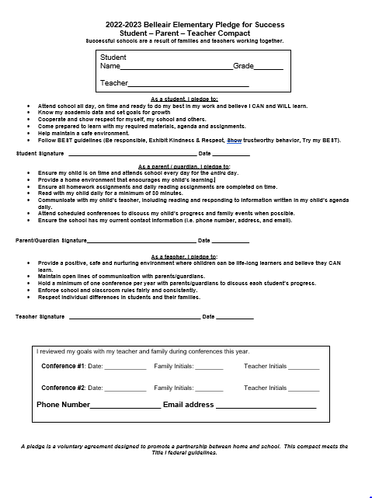
Belleair Elementary School Compact
Notes:
Highlight any things that unique to your school’s compact.

Slide 11
Parent Advisory Council (PAC)
The District has a Parent and Family Engagement Plan. The summary of the plan is in the Title I School & Family Partnership Overview.
You may access the full plan at www.pcsb.org/titleone
The Parent Advisory Council (PAC) is responsible for reviewing and revising the District PFEP.
PAC will meet virtually or in-person with the district’s Title I staff.
Each school is committed to having at least one member representative on PAC.
PAC meets twice a year, if you are interested in representing our school please notify, Renee Kelly
Notes:
Please add your PAC representative in slide and share with your Title I Specialist.

Slide 12
Recruitment Video: We Want you !
Parent Advisory Council (PAC) Video
Notes:
Please play the 1-minute video to share with families about the PAC and the interest form (which is on the next slide).

Slide 13
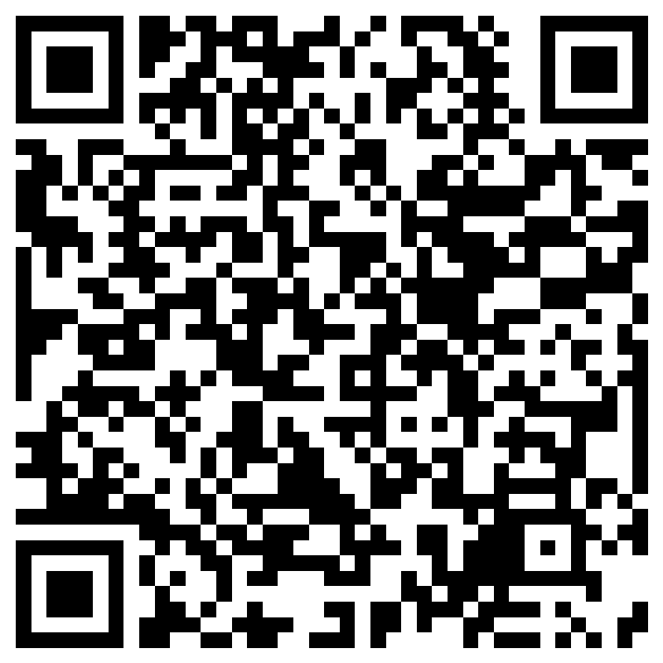
Parent Advisory Council (PAC) Interest Form
Notes:
Please complete the form if you are interested in representing your school/community.
Please allow a minute for interested families to complete the form during the meeting.
Here is the link for you to share also: https://forms.office.com/r/XYv54tECMy

Slide 14


Shift to New B.E.S.T. Standards
Notes:
All curriculum, instruction and assessments are based on student-centered expectations.
FSA → Transition to BEST!
https://www.flgov.com/2021/09/14/governor-desantis-announces-end-of-the-high-stakes-fsa-testing-to-become-the-first-state-in-the-nation-to-fully-transition-to-progress-monitoring/

Slide 15


Florida Benchmark For Excellent Student Thinking Standards (B.E.S.T). You may read more information by visiting, http://www.fldoe.org/standardsreview/
Notes:
All curriculum, instruction and assessments are based on student-centered expectations.

Slide 16

New Assessment: FAST
More information can be found about the FSA Transition to FAST:
https://feaweb.org/fsa-transition-to-fast/
Source: https://www.flgov.com/2021/09/14/governor-desantis-announces-end-of-the-high-stakes-fsa-testing-to-become-the-first-state-in-the-nation-to-fully-transition-to-progress-monitoring/

Slide 17
Please take the time to participate in our survey.
Your feedback is greatly appreciated!
Notes:
Please duplicate Microsoft Forms provided or create school survey. To generate a QR code hover over your school’s survey and and right click. Create QR code for this page will be an option.
https://forms.office.com/Pages/ShareFormPage.aspx?id=BZM8c9c5GkaGb_3ye_PH_x-1YNVO6C1FkgA88U6PR2tUNEQzTU0wNkZXVUxVTlpEMU81NkJFMlJNTi4u&sharetoken=FXXhmgwFjSnl0sNz61ki

